Slide 1
Putting the ‘Sec’ in DevOps
Matt Rose, Global Director of AppSec Strategy

Slide 2
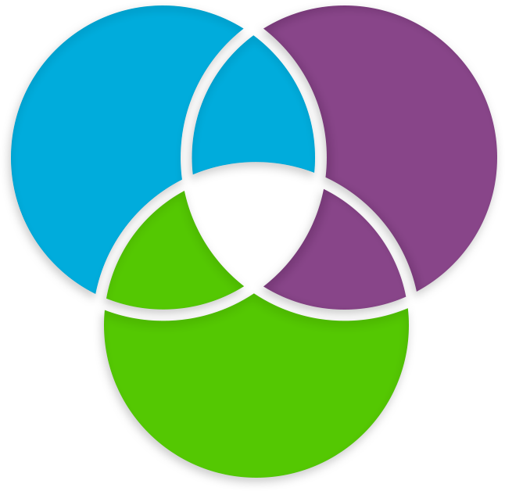
What Is DevOps About?
DevOps is about:
Processes
Connections
Automation
… and Tools
Develop
Test
DevOps
Deliver

Slide 3
Application Security Technologies in DevOps
SAST – Static Application Security Testing
IAST – Interactive Application Security Testing
DAST – Dynamic Application Security Testing
RASP – Runtime Application Self Protection
WAF – Web Application Firewall
OSA/SCA – Open Source Analysis

Slide 4
DevOps Building Blocks
Development
CI
CD
Production
The DevOps Building Blocks

Slide 5
Where Security Fits in DevOps
Development
CI
CD
Production
The DevOps Building Blocks
SAST
Incremental SAST & OSA/SCA
IAST/DAST
& Pen Tests
WAF/RASP

Slide 6
What Does Agile Mean to You?
Agile means different things
to different people?

Slide 7










The Developer’s Process
Check-out code from SCM
Develop
Compile
Test
Functional Testing
Pull dependant binaries from binary repository

Slide 8
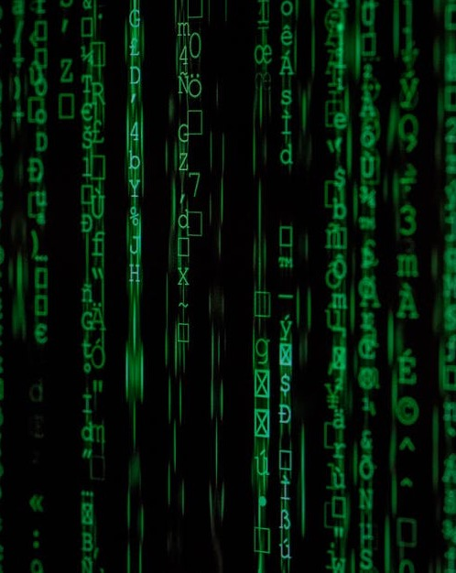
So What About CI?
CI is the process of integrating code into a mainline code base.
Implementing CI is, therefore,
as simple as using the right tools.

Slide 9
So What About CD?
CD is a software development practice in which every code change goes through the entire pipeline toward the end user.
To achieve CD, you have to organize your software testing, staging and deployment processes in a way that automates them as much as possible and makes them continuous.
These processes take different forms, depending on the culture of the team and the type of app it is creating.

Slide 10
Continuous Delivery vs. Continuous Deployment
Continuous Delivery
Code
Done
Unit
Tests
Integrate
Auto
Auto
Auto
Acceptance
Test
Manual
Deploy to
Production
vs.
Continuous Deployment
Code
Done
Unit
Tests
Integrate
Acceptance
Test
Deploy to
Production
Auto
Auto
Auto
Auto

Slide 11
Shifting Left Isn’t Enough…
The further right the project is on the
DevOps Scale the further left it should start implementing security checks.
Code done
Unit Tests
Integration
Acceptance Test
Deployment

Slide 12
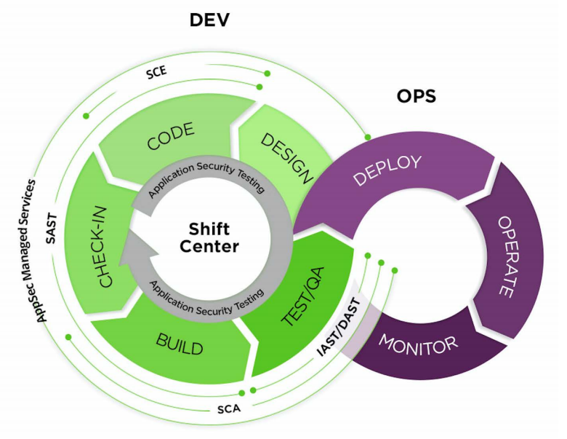





Security in an SDLC & DevSecOps Environment
CLI, Web Services API
Data Export API

Slide 13
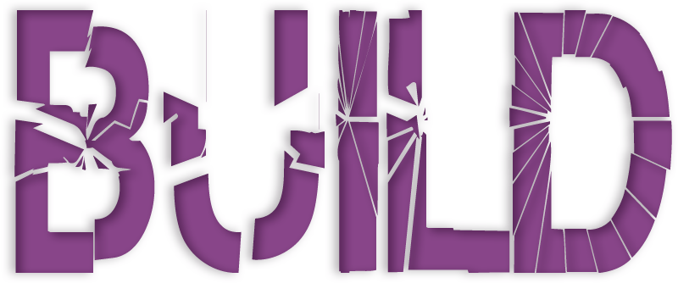
Build Break is a Sensitive Issue

Slide 14
Don’t Let Security Be the Build Breaker
When CI breaks (and it breaks), it impacts everyone and everything in the process, creating a significant delay in the release cycle.
In order to avoid build breaks, you should start implementing security before
the CI stage.
If you have 365 developers and each developer breaks only a single build once a year you have
an average of one build break per day.

Slide 15
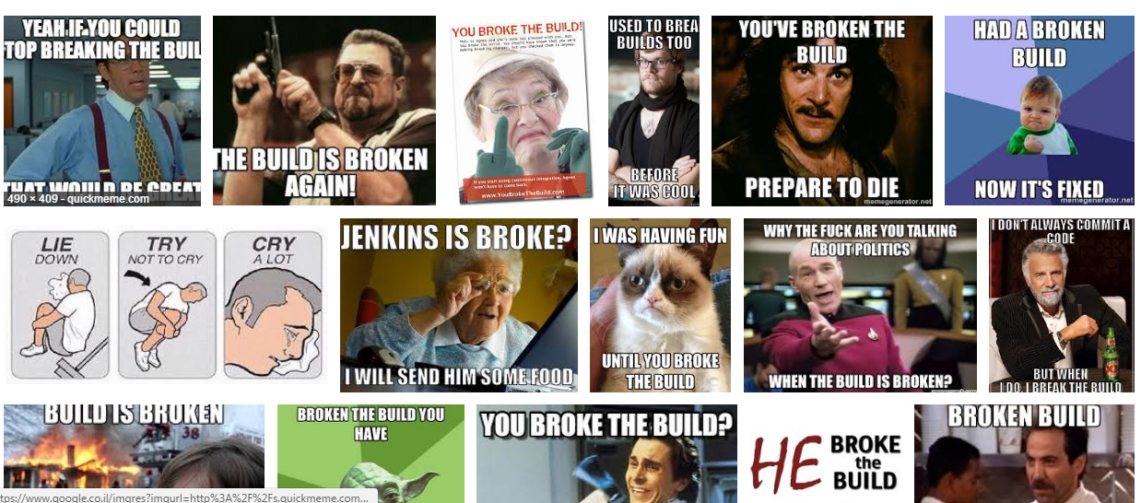
Build Break is a Sensitive Issue

Slide 16

Security Policy
Policy for:
  Legacy code security findings
  New code security findings
Evolving segregated policy based
on vulnerability type or age
Open source vulnerabilities policy

Slide 17
Where Does Security Clash with DevOps Requirements?
Speed
Full code scans too long
Special requirements to initiate scans are time consuming
Stability
Build breaks have to be justifiable, therefore accuracy is key

Slide 18
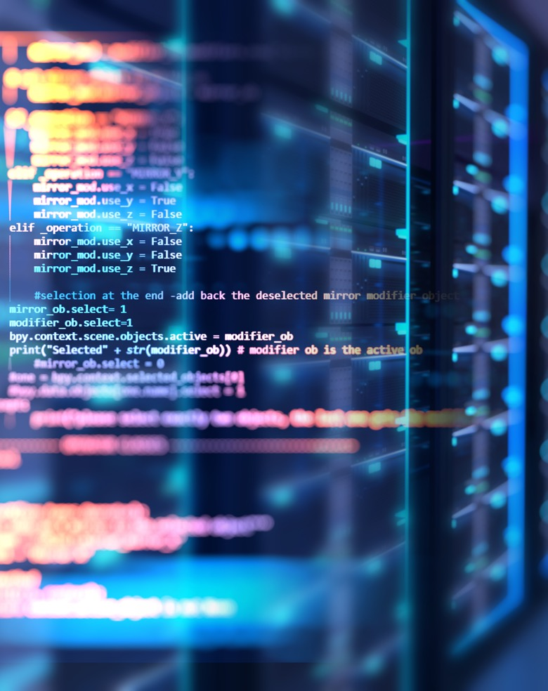

Summary
Develop security policies that fit the DevOps flow
Shift security left, middle, and right
Mind open source

Slide 19
Thank you

